Slide 1
Game Development
with Unity3D
Yingcai Xiao

Slide 2
Outline
IDE
Engine
Assets
Tutorial
Examples
Inside

Slide 3
Game Programming Components
The Gang of Four (G4) for Interactive Animation
  Controller (Input)
  Game Objects (Geometry and Attributes)
  Dynamics (Key Frame Animation)
  Event-driven Programming (EDP: connects inputs to animation scripts)

Slide 4
Unity 3D IDE
IDE: Integrated Development Environment
Game Engine: library to support G4.
Packages/prefabs/assets: prebuilt game objects and scripts
Programming interface: drag-and-drop visual interface
Create once and run anywhere: Mac, Windows, smart phone (iPhone, Android), game devices.

Slide 5
Unity 3D: Create Project
Create your first Unity3D project.

Slide 6
Unity 3D: Project
Start Unity
File->Create Project
Select Assets (Character, Lights, Scripts, Sky, Terrain, Tree)

Slide 7
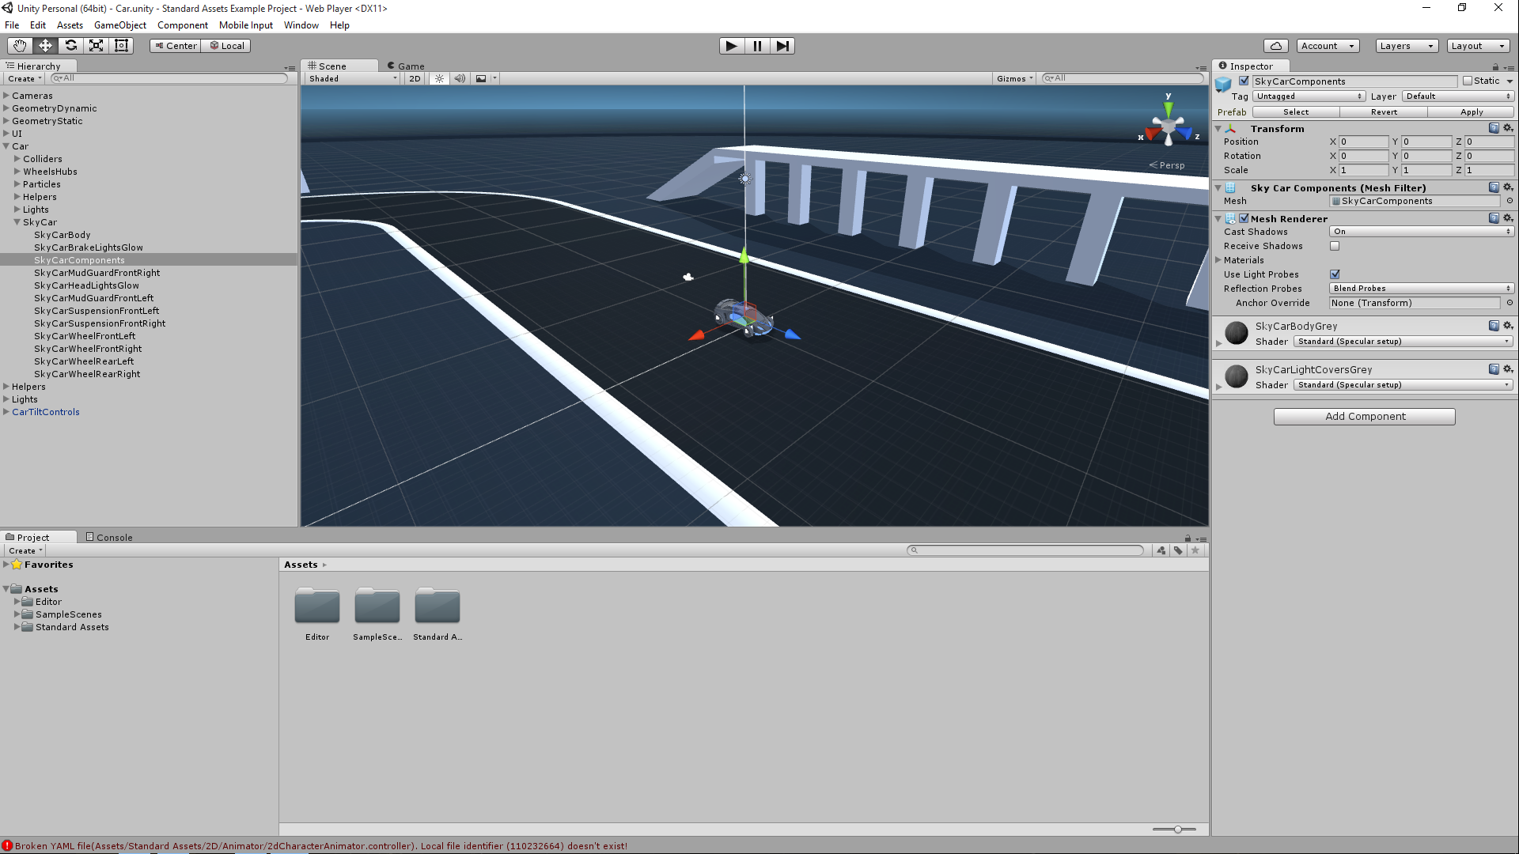
Unity 3D: IDE GUI

Slide 8
Unity 3D: Objects – Terrian and Trees
In the hierarchy pane select Create->Terrain.
Go to the Inspector, click on one of the action icons in Terrain (Script) to adjust height, paint surface, smooth height, paint texture, place trees, paint details, terrain setting.
To place trees, you have to “Edit Trees -> Add Trees” first to add different types of trees.
In the Add Trees popup window, you need click on the little circle at the right-most of the “Tree” row.
Select, say, Palm and than click on “Add” in the “Add Tree” window.
Go back to the Inspector, select “Palm” from available “Trees” to add.

Slide 9
Unity 3D: Player
Make sure to save the scene “File->Save Scene” (Ctrl S”) and save the project “File->Save Project”
Next, we need add the player.
In the Project window, drag “Standard Assets->Character Controllers->3rd Person Controller” to the Hierarchy window.
In the Hierarchy window, double-click on the 3rd Person Controller.
Click on the “Move selected object” icon. Then move the controller to the top of the terrain. You may have to adjust your view angle by clicking on the ‘xyz” icon to see the position. Click the middle of the icon to get the perspective view.

Slide 10
Unity 3D: Play
Now click on the “Play” icon and use the arrow keys (CLI) to controller the player.
You should see the player running around and make sure he does not run off the edge.

Slide 11
Unity 3D
More on Game Objects

Slide 12
Unity 3D: More Game Objects
Background Objects: Terrain and Sky
  Terrain: elevation grid, adjustable height, texture,
  Sky: texture, static view
  Add-ons: trees, stones, …
Foreground Objects: Objects can be animated.

Slide 13
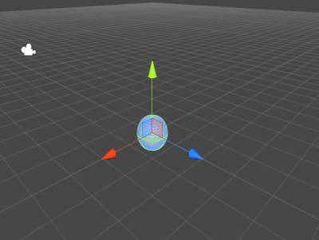
Object Creation
GameObject->Create Other ->Sphere

Slide 14
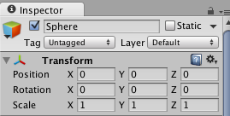

Inspector and transform component
Moving ,translation , rotation and scaling tools

Slide 15
Unity 3D: More on Game Objects
Rigid Objects: non-deformable with physical properties (gravity, inertial).
Non-rigid Objects:
  Deformable: changeable geometry
  Breakable: changeable topology.
Intangible Objects: No predefined shape.
Fire, clouds, …

Slide 16
Unity 3D: Object Interactions
Rigid Objects: gravity automatically added through the physics engine of Unity3D.
Collision Detection: box proxy, sphere proxy, no proxy.
Collision Events: event handler, objects identification.
Event Handlers: need to identify objects and write scripts to handle reaction.

Slide 17
Unity 3D: Collision and Physics
Click on the Sphere in the Hierarchy
Click on Component->Physics->RigidBody
In the Inspector, change the Mass to 30.
In the Hierarchy, select 3rd Person Controller->Bip001
Click on Component->Physics->RigidBody and Component->Physics->Box Collider
Now “Play” again, you should be able to kick the game object.
Stop the animation by click on the “Play” icon again.

Slide 18
Unity 3D: Particle Systems
Project->Standard Assets->Particles -> Fire -> Flame
Drag it to the Hierarchy.
Play again.

Slide 19
Unity 3D
Create Your Own Animation

Slide 20
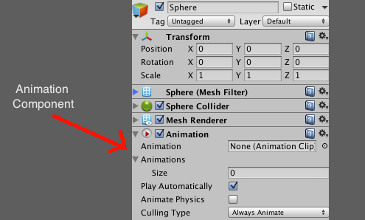
Animation
Click on any object.
Component->Miscellaneous->Animation

Slide 21
Animation
Window->Animation
Click on the record button(red button) on the top left. It will start to recode the key-frames.
Save a new animation clip file.
Click on Add Curve button. This way allows you to select different animation types. You can add multiple types of animation for each object.
Select transform → position, rotation or scaling.

Slide 22
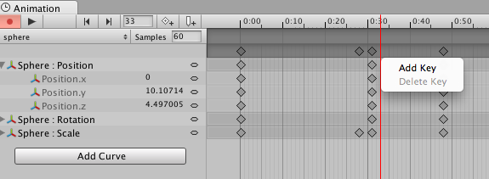
Animation
Add key frame on the time line as many as you want.
For each key frame, you can modify any attributes that belong to it.
Click on the red button again to close the animation clip.

Slide 23
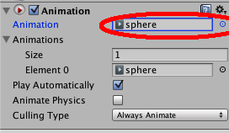
Animation
Go back to Unity window.
Under Inspector → Animation , change the name of animation clip from none to the one that you have already made.

Slide 24
Animation Event
Allows you to call functions in the object’s script at specified points in the timeline.
Add a new Animation Event by double-clicking the Event Line or by using the Event button.

Slide 25
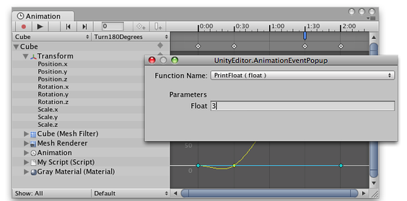
When you add an event, a dialog box will appear to prompt you for the name of the function and the value of the parameter you want to pass to it.

Slide 26
Unity 3D
Inside a Game Project

Slide 27
Unity 3D : Inside a Game Project
Project: directory and files for a specific game project e.g. New Unity Project 1.
C:\Users\xiao\Documents\New Unity Project 1
\Assets (anything you can reuse)
\Library (binary files of Unity libraries, e.g. physics)

Slide 28
Unity 3D: Assets
C:\Users\xiao\Documents\New Unity Project 1\Assets (anything you can reuse)
\Standard Assets
\Scripts
\Materials
\Artwork

Slide 29
Unity 3D: Standard Assets
C:\Users\xiao\Documents\New Unity Project 1\Assets\Standard Assets
Objects: (Look)
\Tree
\Terrain
\Charater
Lights: (Look)
\Light Flares
\Light Cookies
Code: (Feel: control, interaction, animation, …)
\Scripts

Slide 30
Unity 3D: Objects
C:\Users\xiao\Documents\New Unity Project 1\Assets\Standard Assets\Charater:
Prefab: (Predefined Objects)
First Person, 3rd Person
\Source:
\Prototype (Look)
Constructor.FBX
\Materials (properties)
\Textures (images)
    \Scripts (Feel: actions)
Java Scripts: ThirdPersonController.js
C#: MouseLook.cs

Slide 31
Unity 3D: Scripts
Languages:
Interpreted : Java Script
Compiled: C#
Usages:
General: under Project\Scripts
ExitOnEscape.cs
Objects: attached to objects
ThirdPersonController.js

Slide 32
Unity 3D: Library
cashe:
for speeding up processing
metadata:
data that describes data
previews:
for previewing scenes
ScriptAssemblies:
compiled object assemblies for scripts

Slide 33
Unity 3D
Have Fun!!!!

